Slide 1
Introduction
to
Programming

Slide 2
Software
User requirements
Problem Analysis
Determine Input & Output
Program
Designing Algorithm
Problem Coding
Testing & Debugging the program
Program Documentation
Instruction

Slide 3
Types of Programming Language
Programming Languages
PL - Programming Language
Low Level PL
High Level PL
Eg - C, C++, JAVA, Python etc etc
Machine Level Language
Assembly Language
Eg - 8085, 8086, 80186, 80286, 80386, 80486 etc etc...

Slide 4
Machine Level Programming

Slide 5
Disadvantages of Machine Level Programming
Computers can understand only binary. Which is 0 and 1. So instructions could be given to computers only using binary codes.
That’s why computer understand only machine level programming language.
Less Readability
Very hard to understand
High Error Prone
Hard to write
Not user friendly at all
Less portable
Uniqueness for each device

Slide 6
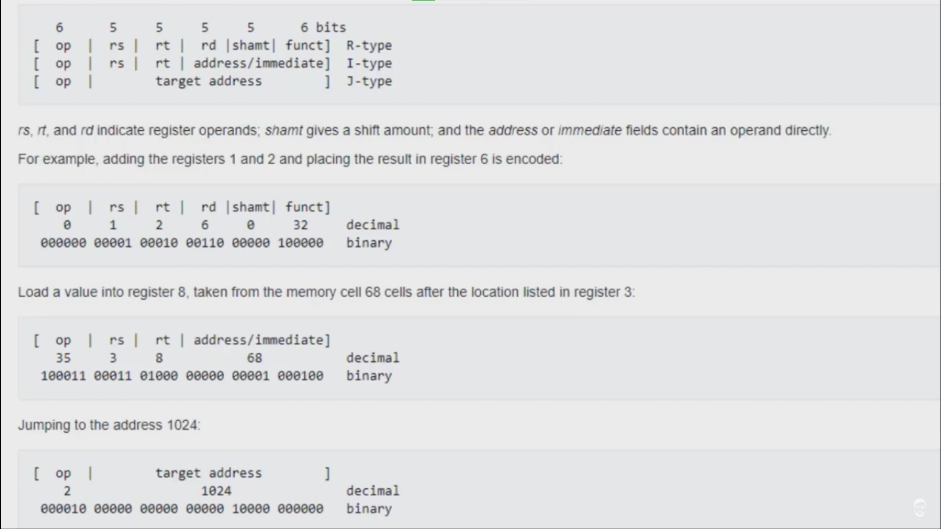

Slide 7
Assembly Language

Slide 8
Disadvantages of Assembly Language
In assembly language instructions are given in English like words, such as MOV, SUB, ADD etc.
So it is easier to understand assembly language programs.
Values stored in Registers (So portability issue is there).
Limited number of registers in the computer. So large scale data won’t be processed.
Hard to write bigger codes because for this one has to remember all the commands which is very tough.

Slide 9
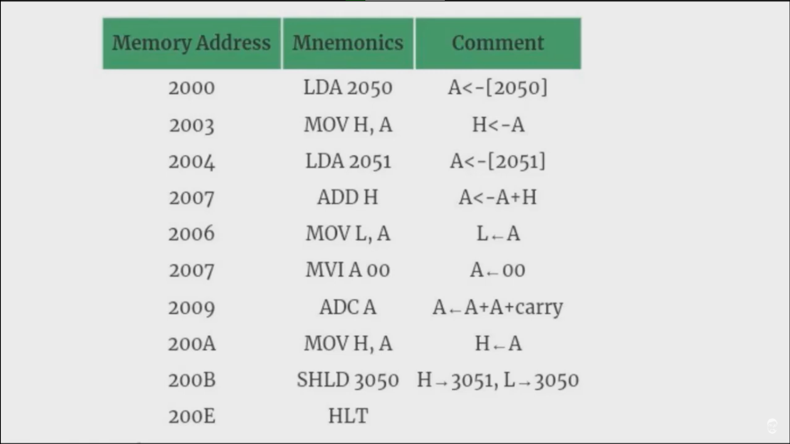

Slide 10
High Level Programming Language

Slide 11
TRANSLATOR
ASSEMBLER
ALL
MLL
}
COMPILER
HLL
MLL
INTERPRETER
ALL - Assembly Level Language
MLL - Machine Level Language
HLL - High Level Language

Slide 12
END

